Slide 1
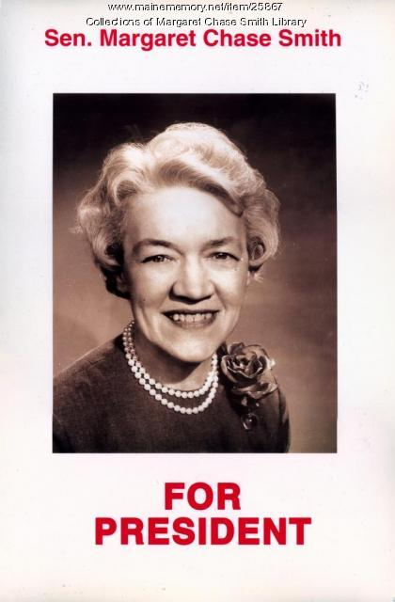
Margaret chase smith
Stories of Excellence
Student Health & Human Services
Office of Human Relations, Diversity & Equity
July 2022
Notes:
Teacher, thank you foro chosing this lesson to share with your students.

Slide 2
Would you rather...
Be able to take back anything you say?
Hear any conversation that is about you?
Notes:
Engage the students in the check in question.

Slide 3
objectives
Reflect on her legacy
Learn about Margaret Chase Smith and her political career
Discusss the importance of her role in the women's rights movement
Notes:
Read the slide aloud for the students.

Slide 4
The early years
Margaret was born in Maine in December 1897.
Her father was a barber and her mother worked as a waitress, a store clerk, and a factory worker.
Margaret started working at the age of 12 and even bought herself a life insurance policy
Notes:
Read the slide aloud for the students.

Slide 5
Time to share
Margaret Chase Smith began working at the age of 12.
Did you start working around that age? Do you know anyone who did?
Notes:
Invite the students to engage in this reflection question.

Slide 6
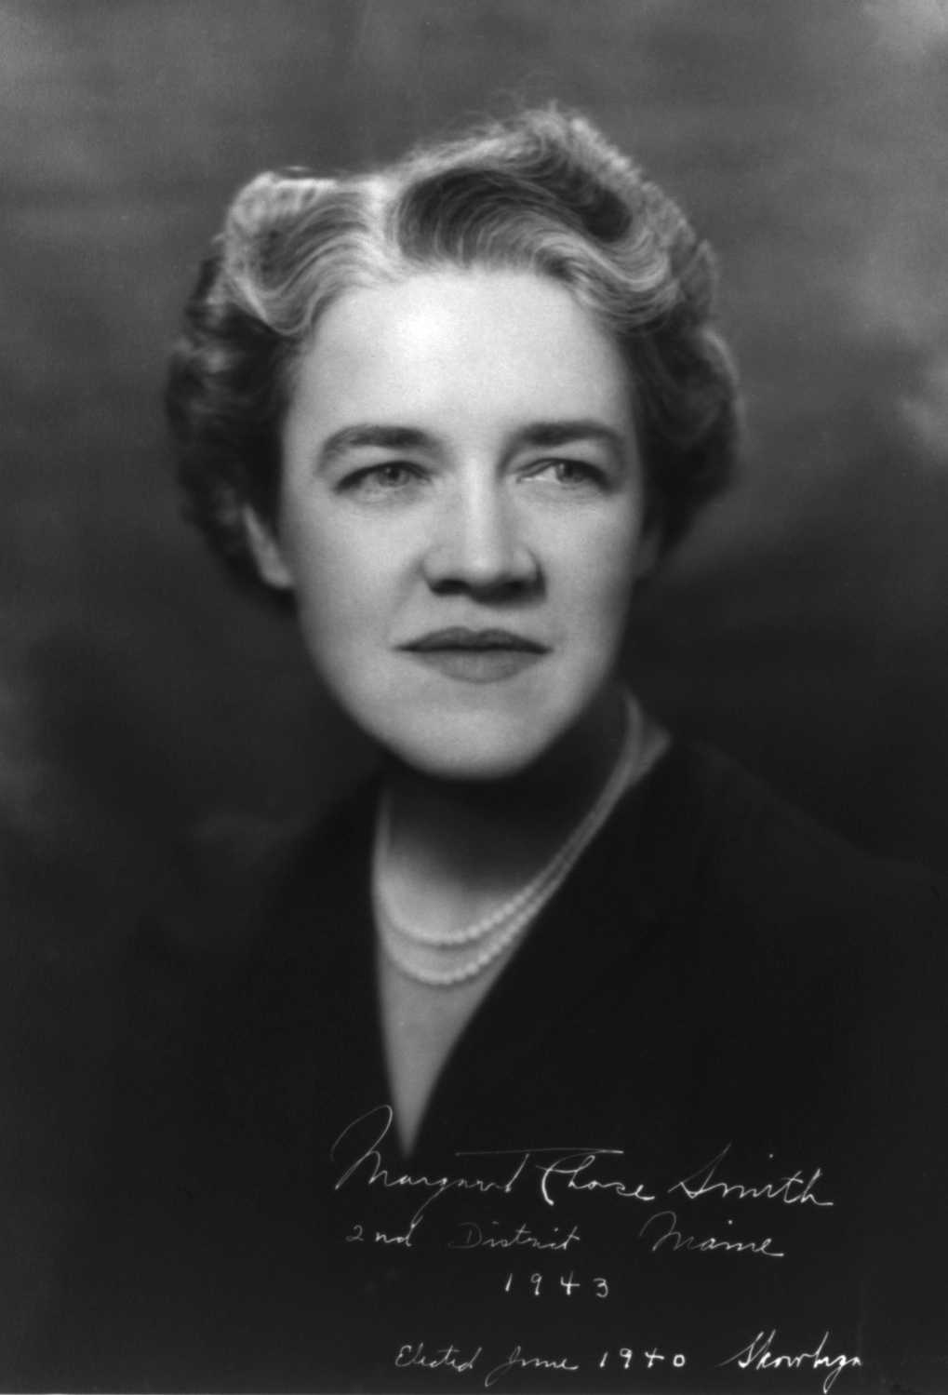
Working Woman
From the time Margaret graduated from high school she worked at various jobs and took on many leadership roles.
When she was 33 years old, Margaret married Clyde Smith, who was 54 years old.
She became active in politics and served on the Maine Republican State Committee for three years.
When she was 39 years old, Margaret and Clyde moved to Washington DC where Clyde served in the US House of Representatives, and Margaret became his secretary.
Notes:
Read the slide aloud for the students.

Slide 7
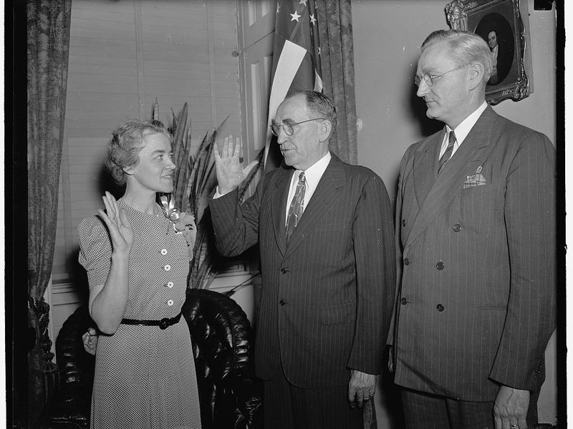
First woman elected to congress from maine
In 1940, Clyde had a heart attack and remained ill and he asked Margaret to run for his seat in the House the following year.
Clyde died soon after his heart attack and a special election was held where Margaret became the first woman elected to Congress from the state of Maine.
Three months later, she was elected to a full 2-yr term.
Notes:
Read the slide aloud for the students.

Slide 8
Time to share
At 43 years old, Margaret was the first woman from Maine to be elected to congress, following the death of her husband.
Does it matter that she got elected to take her husbands role? What do you think about this?
Notes:
Invite the students to engage in the reflection question.

Slide 9
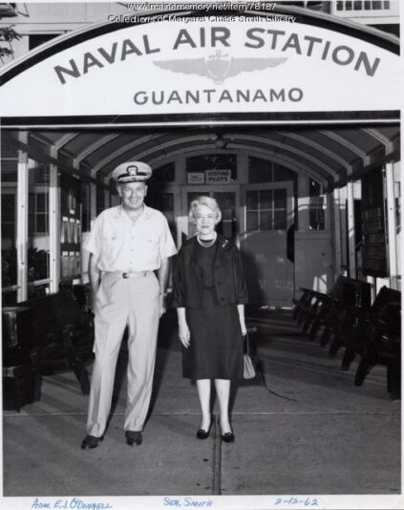
Time in the house of representatives
Margaret had some major victories during her time as a member of the House of Representatives.
Some notable wins include being the first and only civilian woman to sail on a U.S. Navy ship and being instrumental in passing the Women's Armed Services Integration Act.
She earned a reputation for breaking ranks with her party.
Notes:
Read the slide aloud for the students.

Slide 10
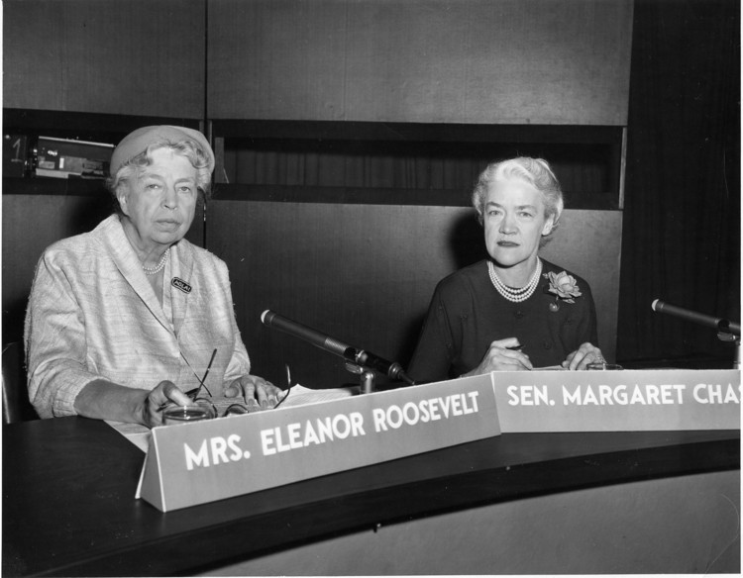
First woman to serve in both the house of representatives and the senate
In 1948 Margaret ran to become a senator of the state of Maine.
After winning the election, she became the first woman to represent Maine in the Senate, and the first woman to serve in both houses of Congress.
Notes:
Read the slide aloud for the students.

Slide 11
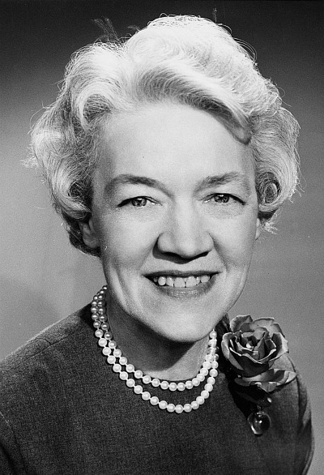
Time in the senate
Margaret gained national attention when she became the first member of Congress to condemn the anti-Communist witch hunt led by her fellow Republican Senator, Joseph McCarthy of Wisconsin.
On June 1, 1950, Smith delivered a fifteen-minute speech on the Senate floor, known as the "Declaration of Conscience," where she defended every American's "right to criticize ... right to hold unpopular beliefs ... right to protest; the right of independent thought."
Notes:
Read the slide aloud for the students.

Slide 12
Speeches of freedom: margaret chase smith
Notes:
Play the video for the students (3:25)
https://www.youtube.com/watch?v=8Bz_c5OfLmA&feature=emb_title

Slide 13
Time to share
In Margaret Chase Smith's famouse speech, "Declaration of Conscience" she speaks about not acting as a Republican or a Democrat, but as Americans with the "right to criticize ... right to hold unpopular beliefs ... right to protest... the right of independent thought."
Do you think her stance remains relevant today? Why or why not?
Notes:
Invite the students to engage in the reflection question

Slide 14
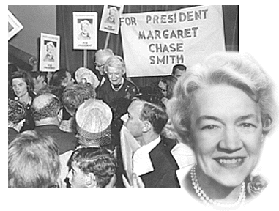
The 1964 presidential campaign
On January 27, 1964, Margaret announced her candidacy for President of the United States.
In 1964, she became the first woman to have her name placed in nomination for the presidency at a major political party's convention.
She declared, "I have few illusions and no money, but I'm staying for the finish. When people keep telling you, you can't do a thing, you kind of like to try."
Smith lost every single primary election
Notes:
Read the slide aloud for the students.

Slide 15
Time to share
Margaret Chase Smith was the first woman to serve in both houses. She was known for breaking ranks with her Repulican party. She even ran for President, all the while knowing that she would not win, but she ran on principle alone. She did what she felt was right, rather than what was popular.
Has there ever been a time when you did what was right rather than what was popular or what others wanted you to do?
How did it work out?
Notes:
Invite the students to engage in the refflection question.

Slide 16
Which is better?
Notes:
Invite the students to egnage in the check out.

Slide 17
Human Relations, Diversity & Equity

Slide 18
Teacher Feedback
Notes:
Teacher, please complete a brief feedback survey by scanning the QR code or using the link below
https://forms.office.com/r/i9UqyyxzTT

